Slide 1
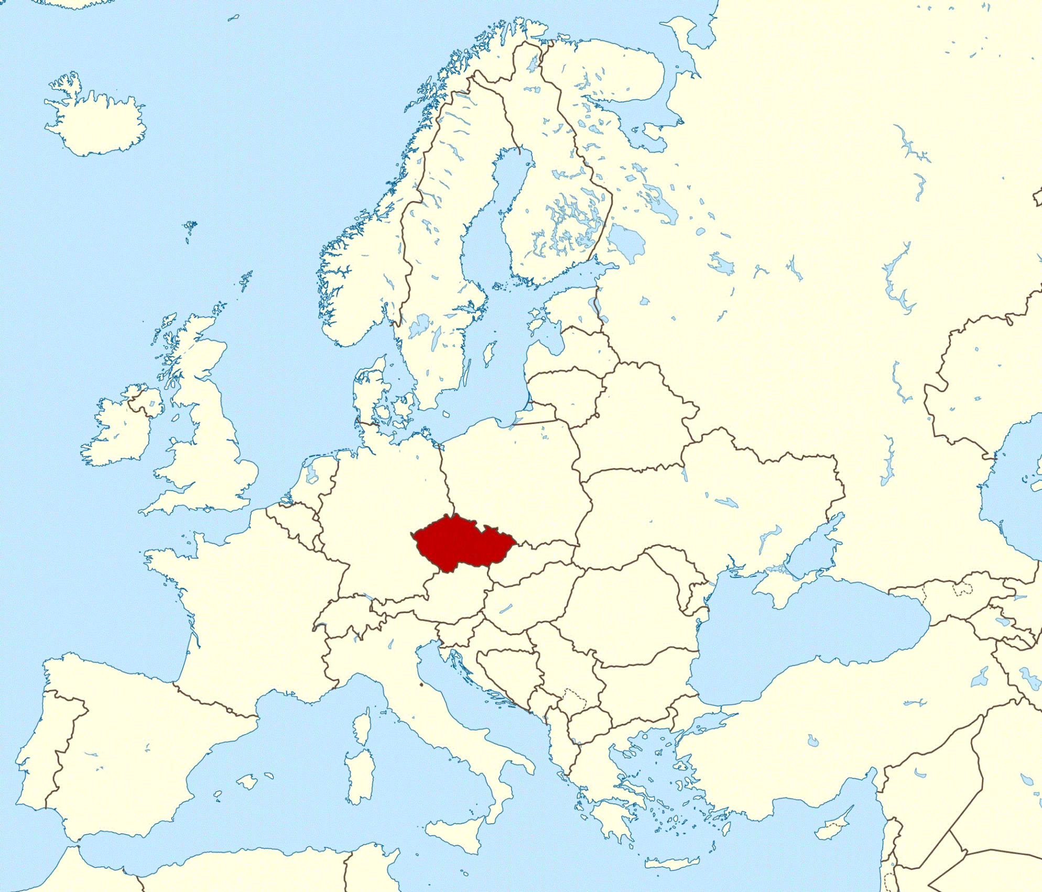
Jakub Ešpandr
24 years
Czech Republic

Slide 3
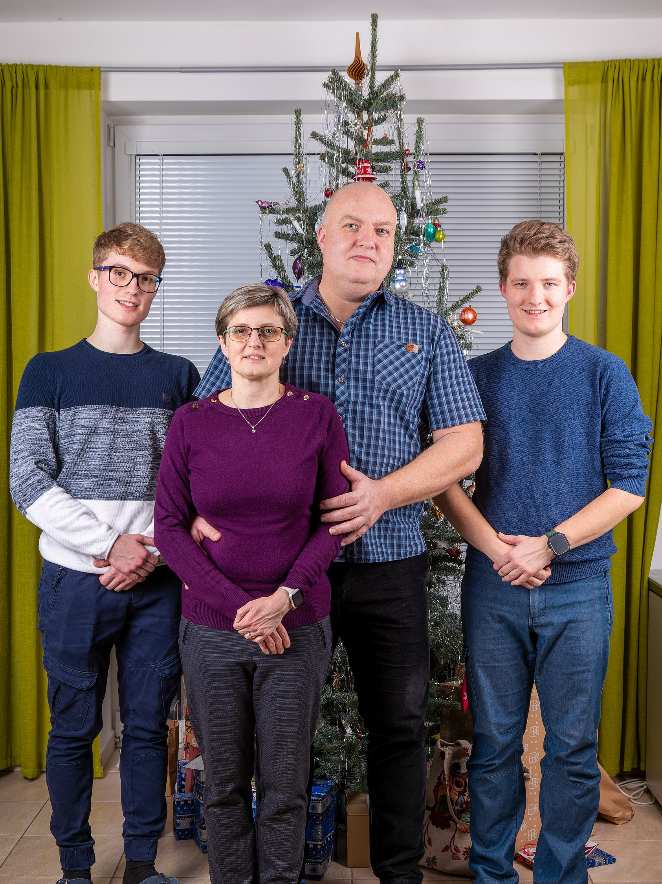

Slide 4
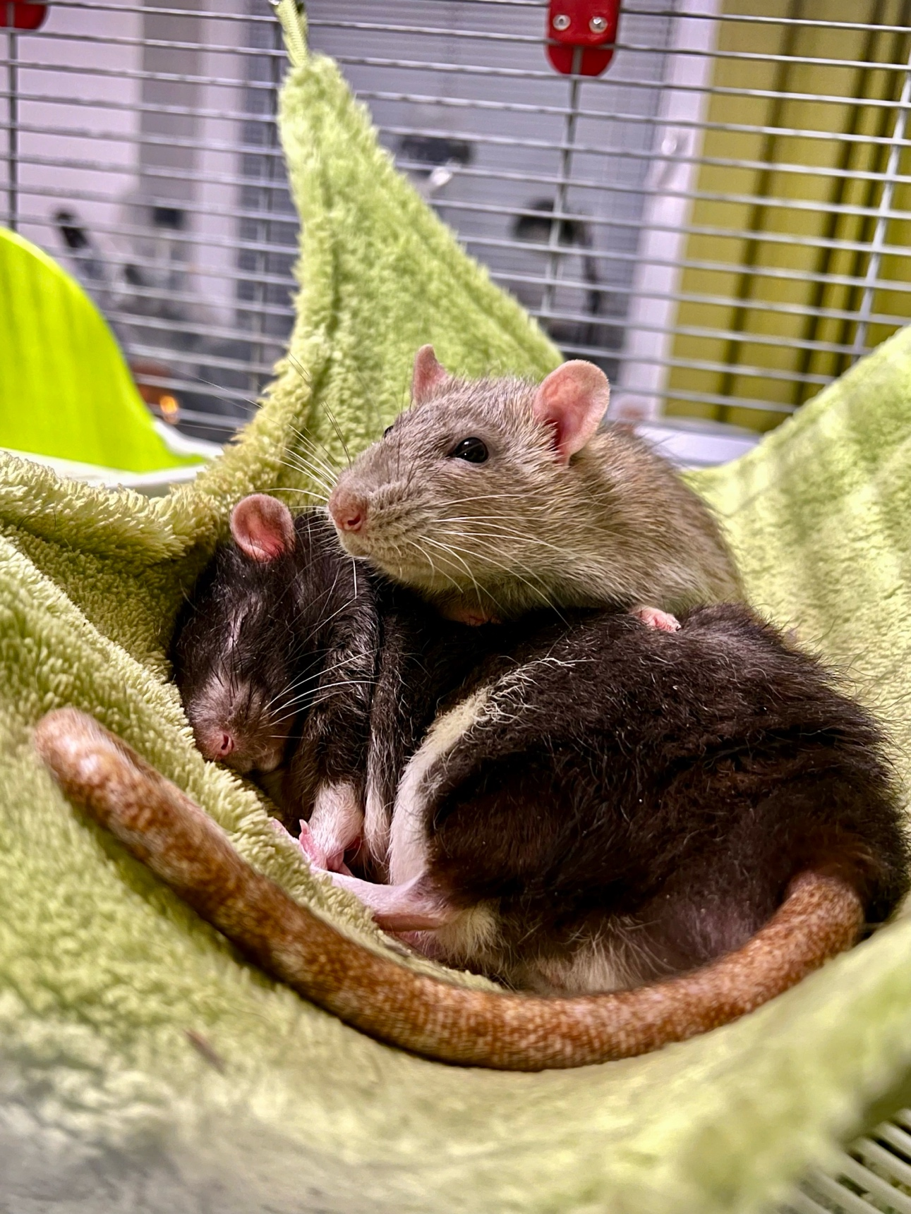
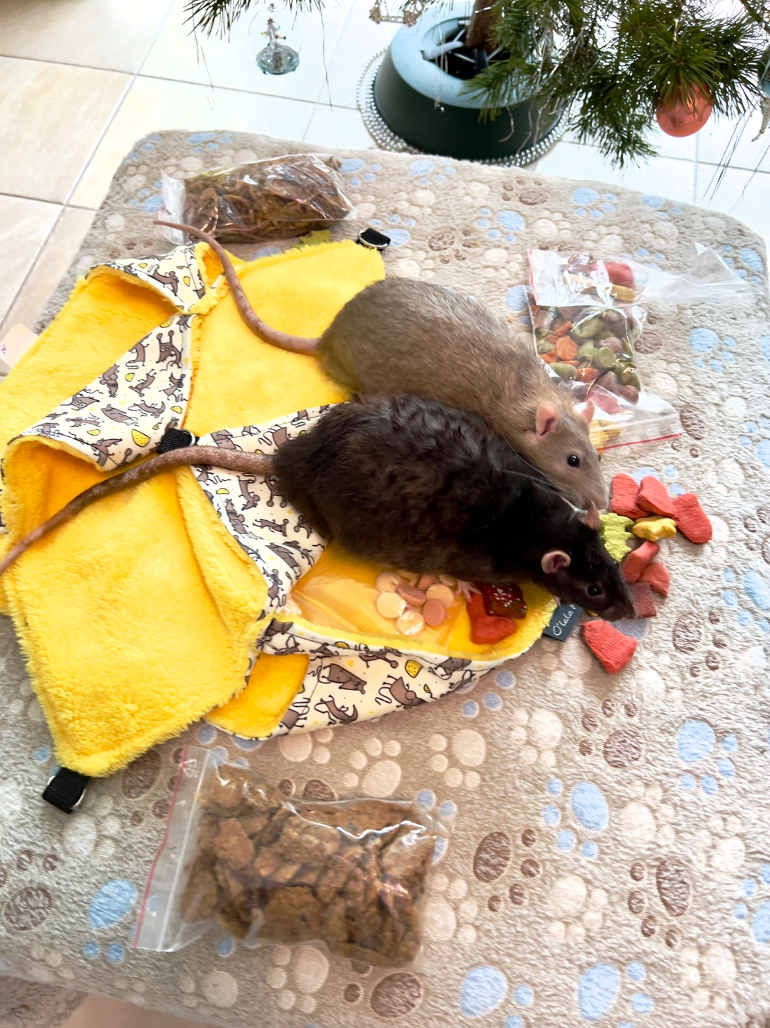
chǒngwù lǎoshǔ – 宠物老鼠
pet rat (fancy rat)

Slide 5
Ziggy
Bert
chǒngwù lǎoshǔ – 宠物老鼠
pet rat (pet fancy rat)

Slide 6
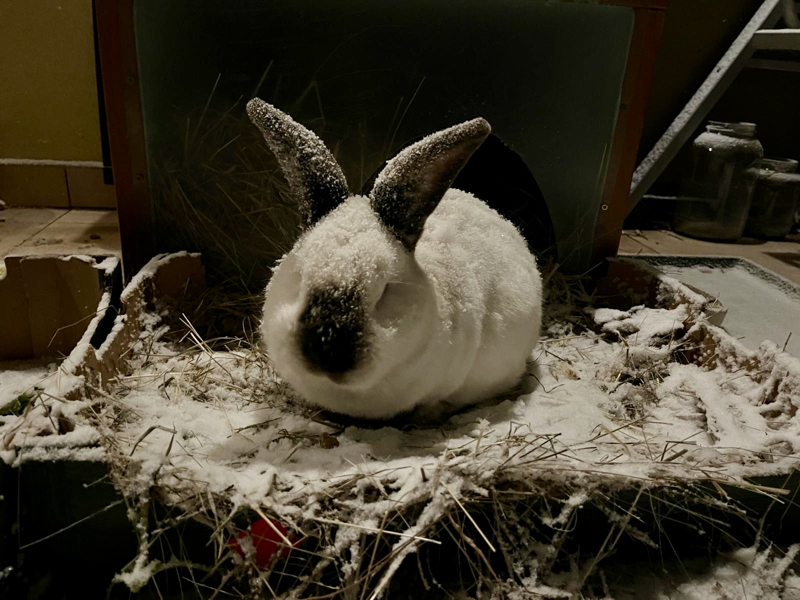

Slide 8
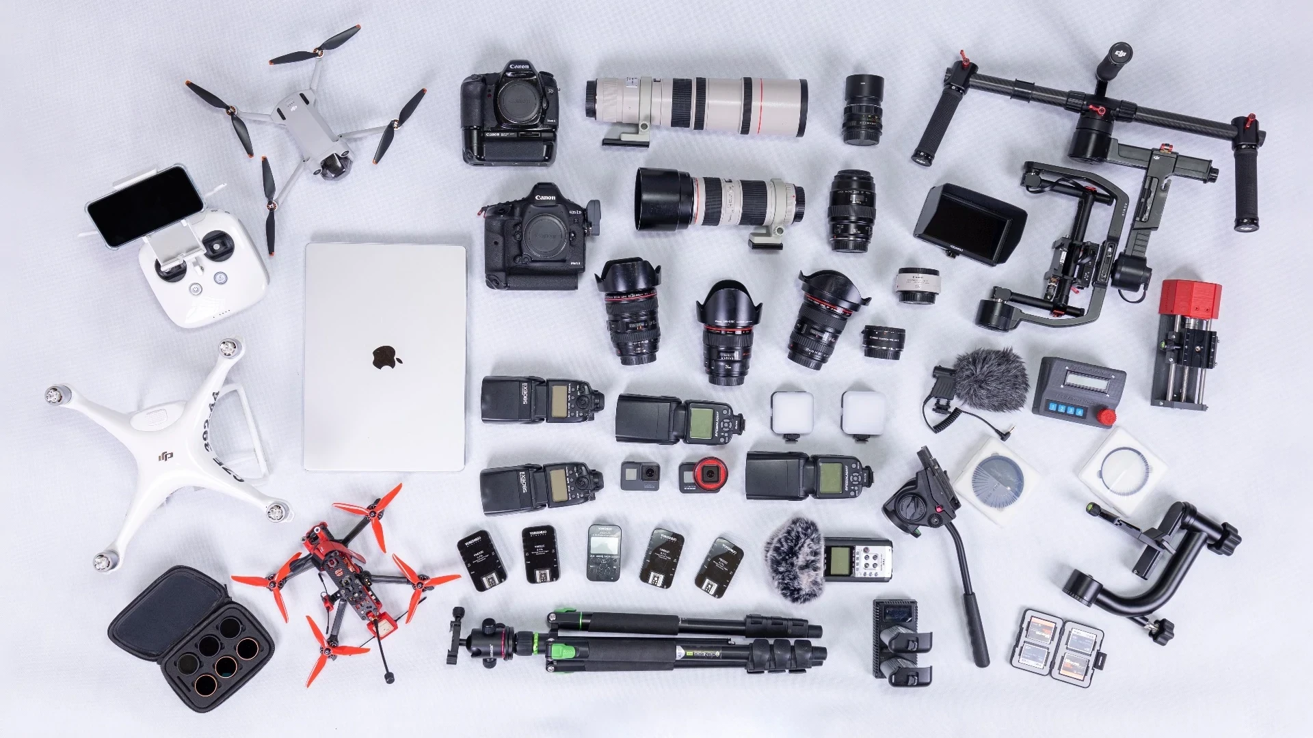
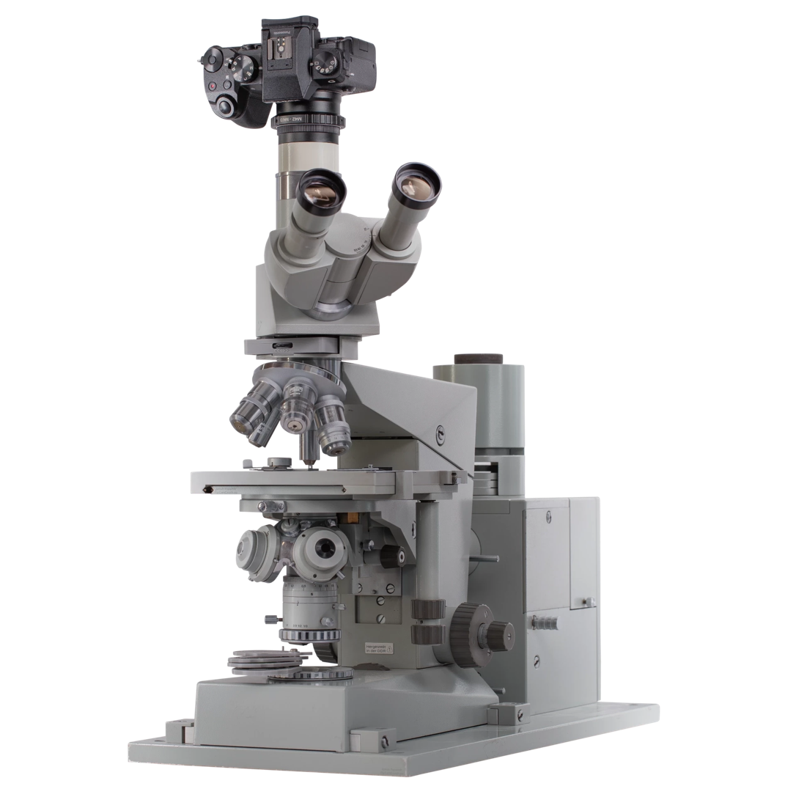

Slide 9
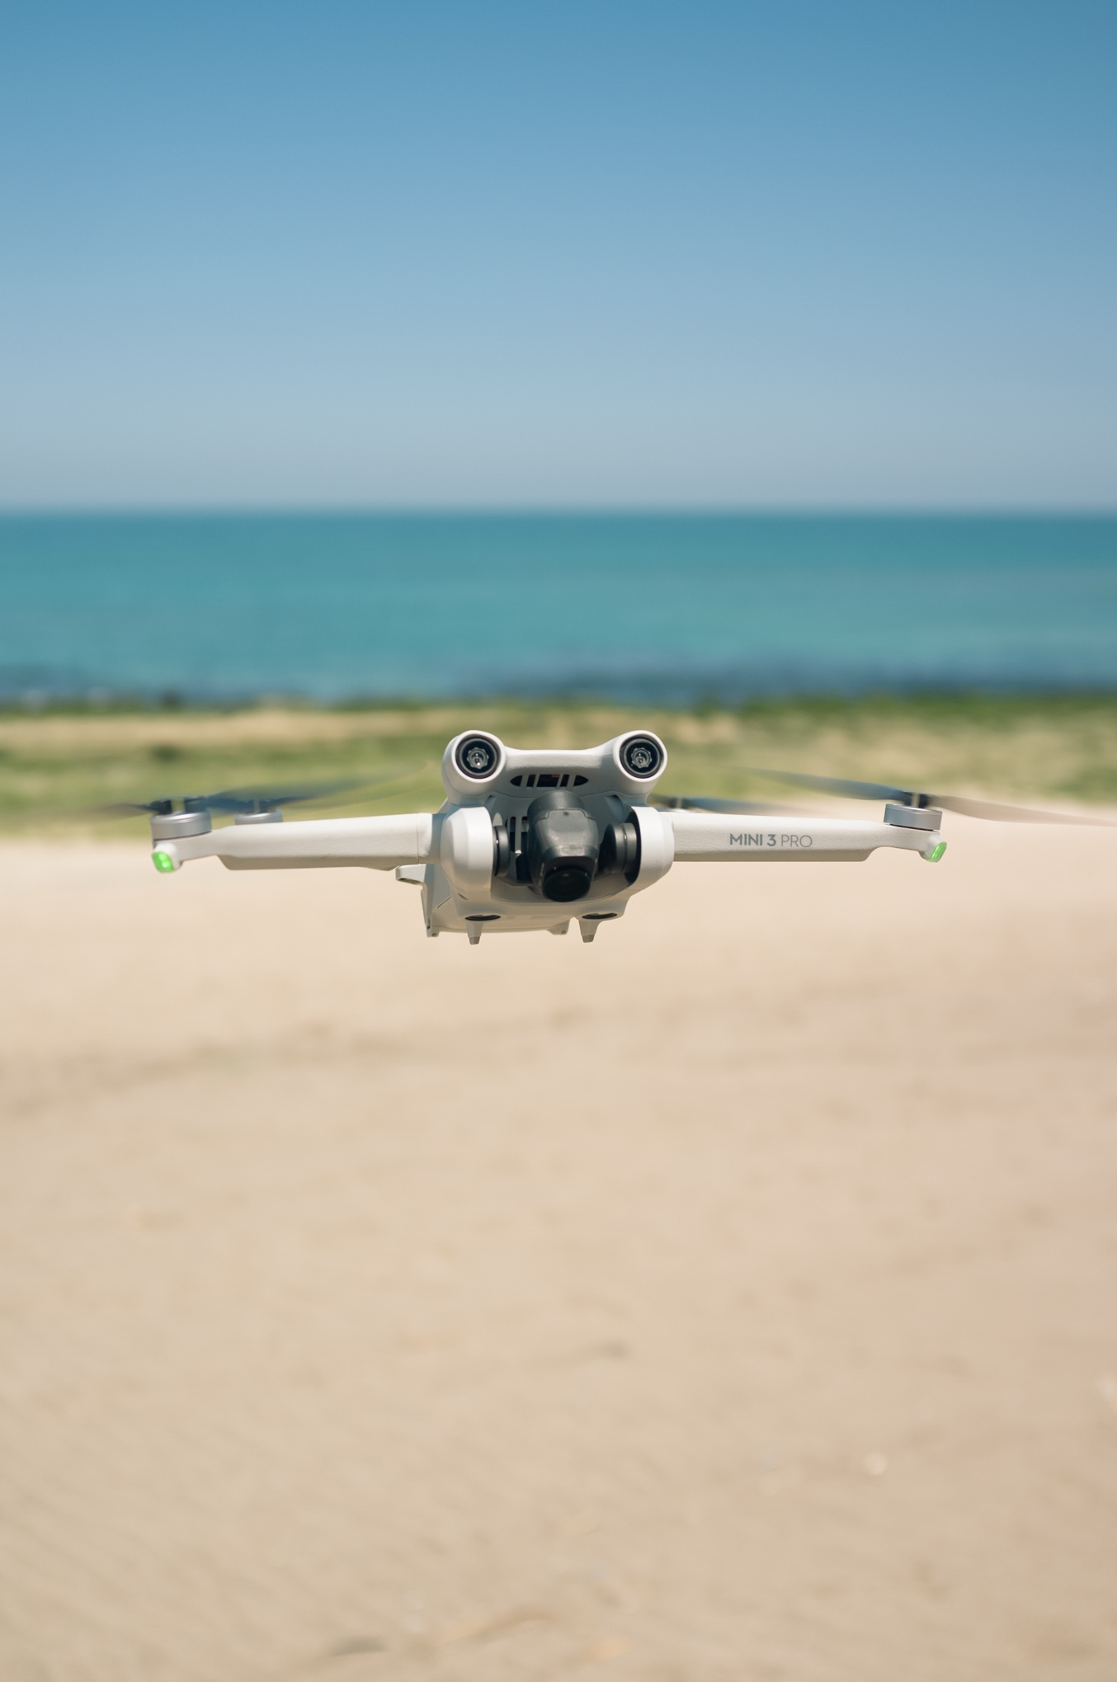
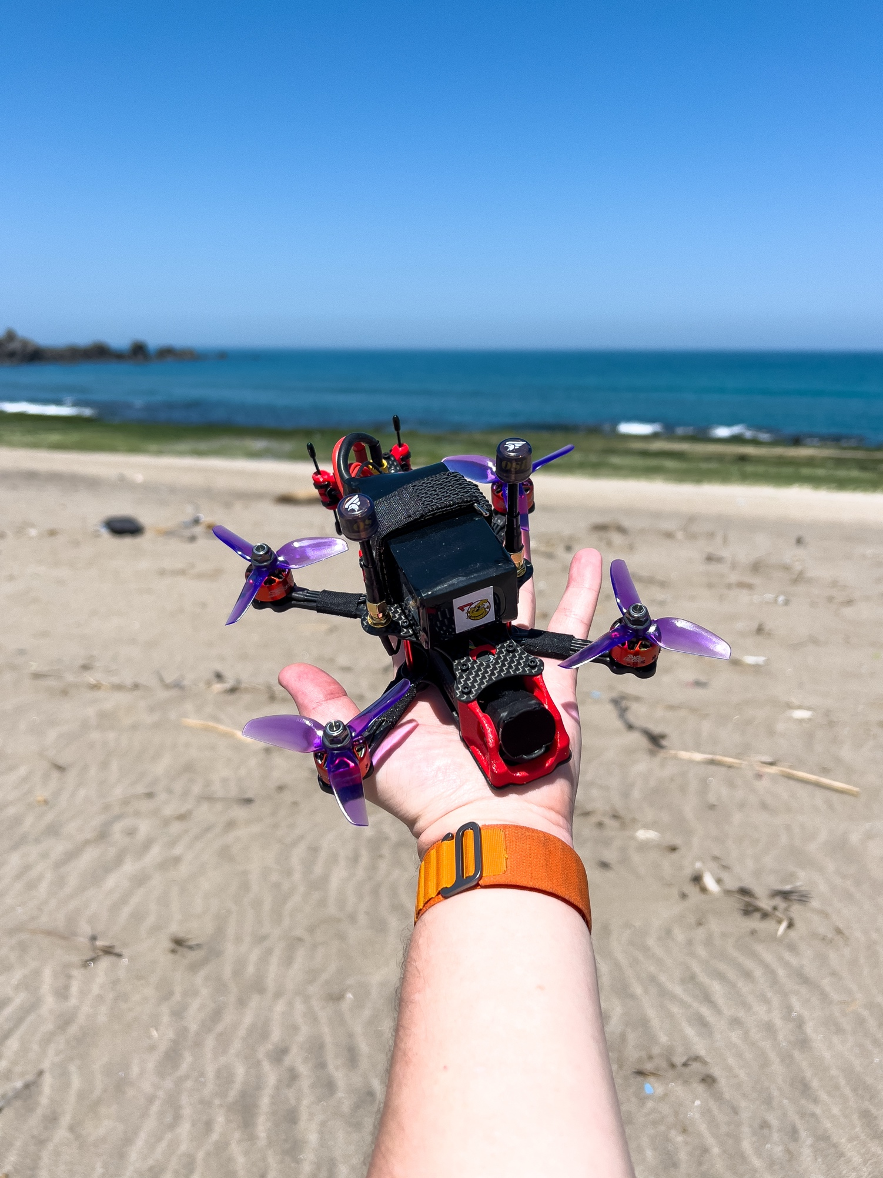
drone = unmanned aerial vehicle
fēi = fly
wú = without (no)
rén = person (human)
jī = machine
fēi wú rén jī – 飞无人机
fly drones
no human machine

